Slide 1
Getting our VR Game ON!
Niveditha Kalavakonda, Ph.D. Student, University of Washington - Seattle

Slide 2
ABOUT ME
Ph.D. student in Electrical Engineering (Systems, Controls and Robotics)
Part of BioRobotics Lab, under the mentorship of Prof. Blake Hannaford
Completed MS in EE (2017) at UW and B.Tech in Electronics and Communication Engineering at Amrita School of Engineering, India (2014)
Work on computer vision and AR/VR development, haptics and controls for medical robotics
Worked with Unity since 2014 to develop simulations for surgery and for rehabilitation

Slide 3
AGENDA
Introduction to Augmented and Virtual Reality Development
Introduction to Unity3D
Development of Augmented Reality Application (Unity3D +Vuforia SDK)
Deply App to Android
Development of game in Unity
Deployment from Unity to Google Cardboard

Slide 4
Introduction to AR/VR Development

Slide 5
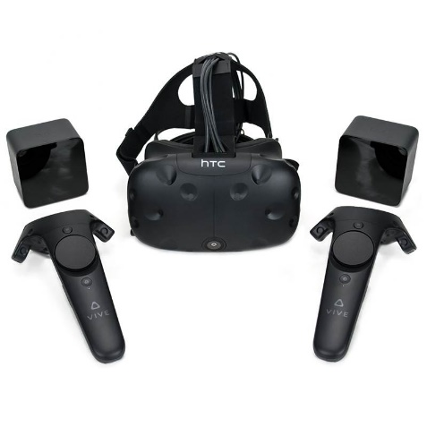
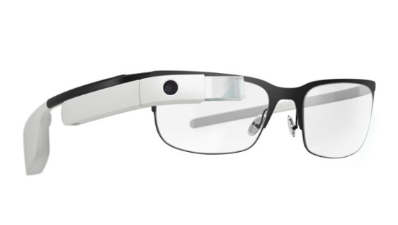
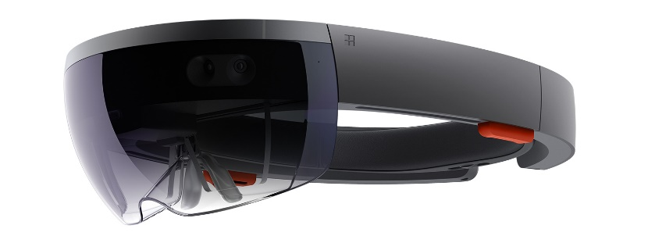
Augmented/Virtual/Mixed Reality
Virtual Reality” (VR) creates a digital environment that replaces the user’s real-world environment
“Augmented Reality” (AR) overlays digitally-created content into the user’s real-world environment
“Mixed Reality” (MR) is an experience that seamlessly blends the user’s real-world environment and digitally-created content, where both environments can coexist and interact with each other
Google Glass
(Courtesy: newsweek.com)
Microsoft HoloLens (Courtesy: microsoft.com)
HTC Vive (Courtesy: mwave.com)

Slide 6
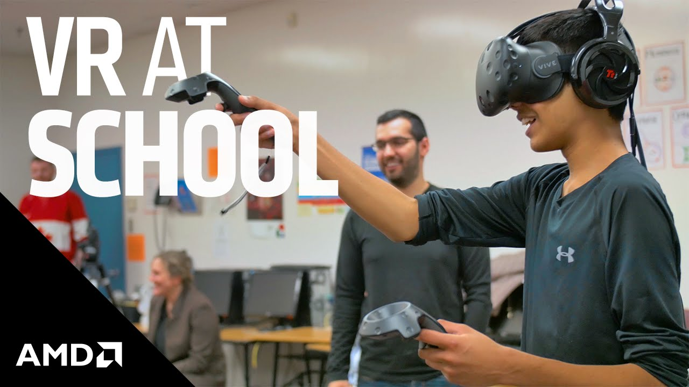
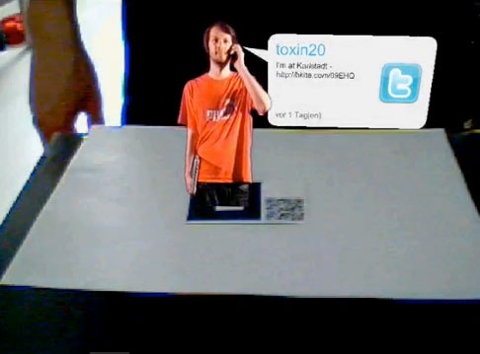
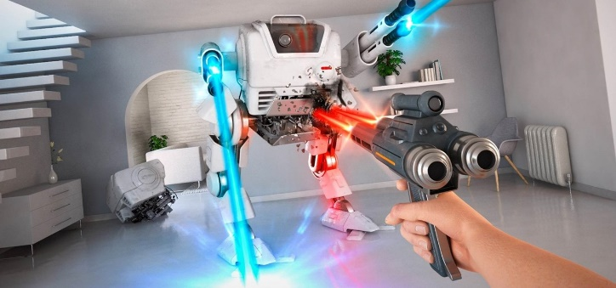
Applications of AR/VR/MR
Games
Healthcare
Education
Shopping
Training workers and on industry floor
Discovery and Distribution
Social
Military training
Robotics,
So much more…!
Courtesy: amd.com
Courtesy: mixedrealitynews.com
Courtesy: mikefrangos.com

Slide 7

EXAMPLES OF VR

Slide 8
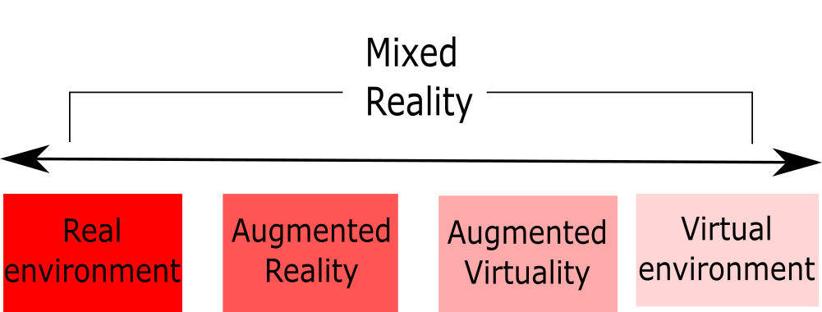

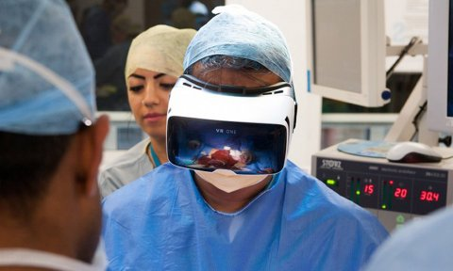
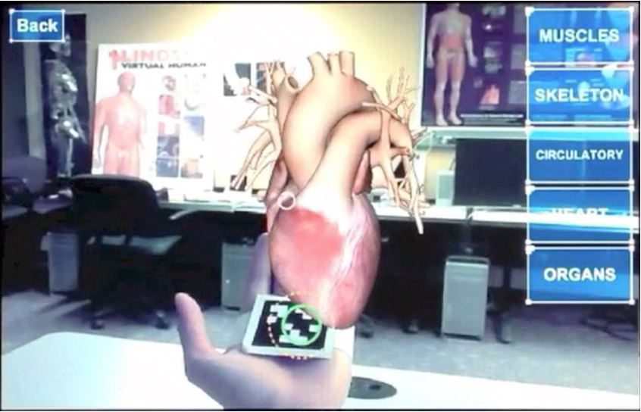
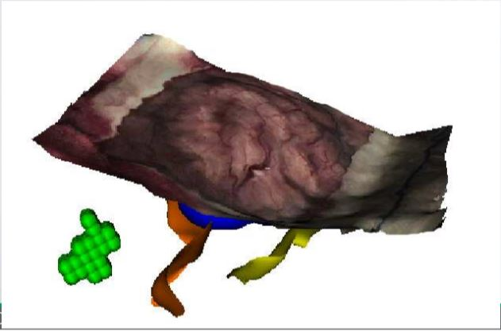
VR Continuum
Courtesy: businessinsider.com

Slide 9
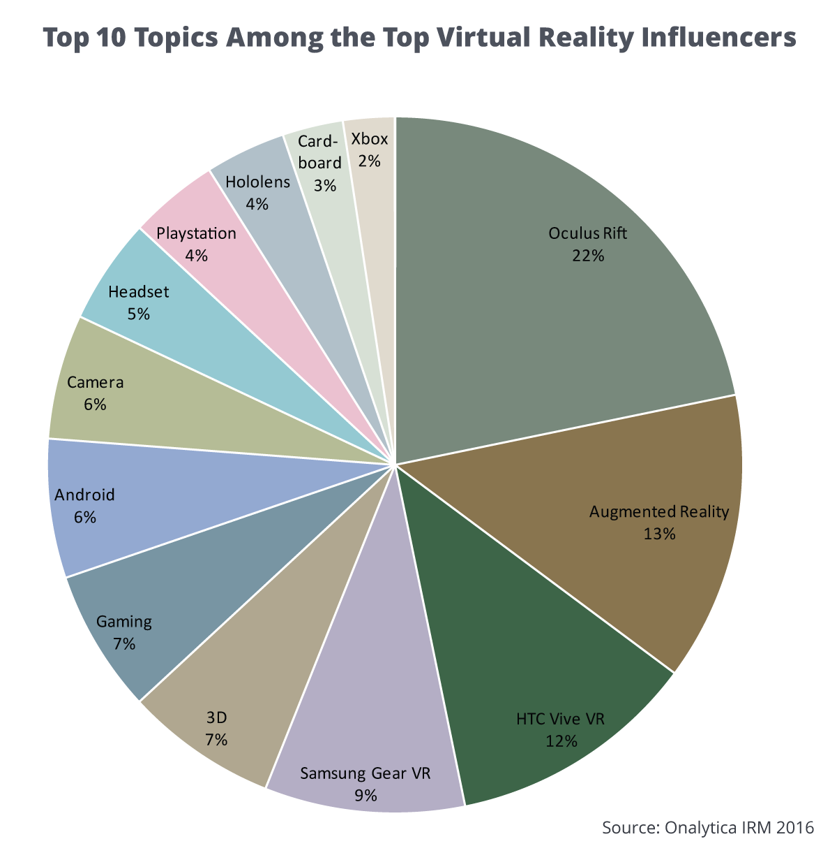
Devices of Interest

Slide 10
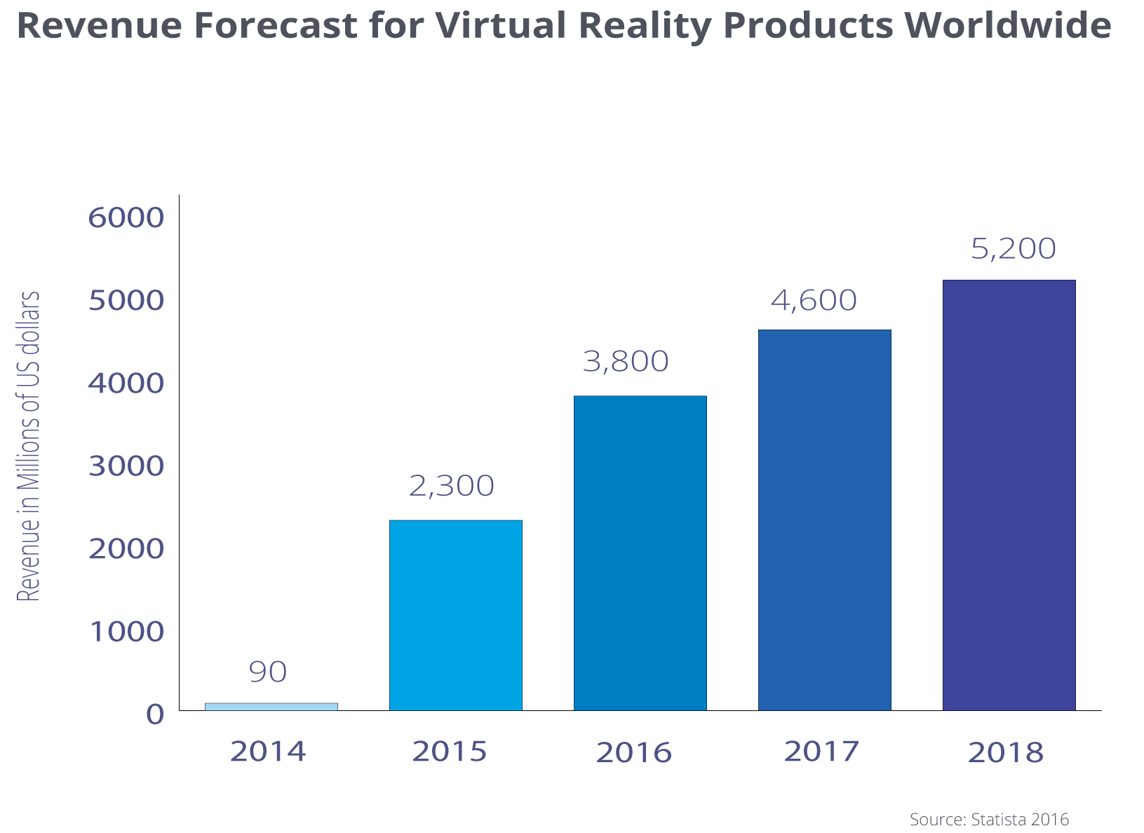
Revenue Forecast – Virtual Reality

Slide 11
Introduction to Unity3D

Slide 12
UNITY - DEFINITIONS
Assets - building blocks of all Unity projects - graphics (textures), models, sound files. The files you use to create the scenario are stored in a folder called Assets
Scenes - scenes are individual levels, areas of game content. Scenes can be loaded on demand.
Game Objects - Assets used in the scene become GameObjects. All GameObjects have at least one component - the Transform component.
Components - Come in various forms. Attach components to and object to add parts of the game engine to the the component e.g a physics component, or a script component

Slide 13
UNITY - DEFINITIONS
Scripts - components used to add, extend or modify behavior of game objects. Unity uses a Behavior class to facilitate the use of custom behaviours.
Prefabs - prefabricated game objects with stored associated components and configuration. Prefabs allow functional game objects to be reused in scenes (spawned) or imported into other projects as external assets. ‘The First Person Controller’ is an example of a Prefab

Slide 14
UNITY INTERFACE
Scene View —where the game is constructed
Hierarchy Panel—a list of GameObjects in the scene
Inspector Window—settings for currently selected asset/object
Game Window—the preview window, active only in play mode
Project Panel—a list of your project's assets, acts as a library

Slide 15
DEVELOPMENT OF AR APP

Slide 16
Weblinks required
https://github.com/nkalavak/ChickTech-Seattle-Feb2018
www.vuforia.com – Create Developer account

Slide 17
Development in Unity - Game

Slide 18
Weblinks Required
https://github.com/nkalavak/ChickTech-Seattle-Feb2018/tree/master/Workshop%20Resources

Slide 19
SKY BOXES AND EFFECTS
Skybox - cubemap - six textures placed inside a cube
Rendered seamlessly to appear as surrounding sky and horizon
Not an object position a player can visit
Only visible in the Game View panel
Water effects created by an animated material applied to a surface

Slide 20
AUDIO EFFECTS
Audio requires an Audio Source and an Audio Listener in the scene
Stereo sound treated as as ambient constant volume and continuously playing in the scene (looped enabled)
Mono sound treated as spatial - gets louder or softer depending on player’s position relative to the audio source position
Supported formats .wav, .mp3, .aiff, .ogg

Slide 21
LIGHTS
Lights (Use it for Illumination, modeling, focus and visual style)
Directional
Point
Spot
Lights can be parented to other game objects
LIGHT TYPE | DESCRIPTION | PRIMARY PURPOSE
Ambient | Reflected Light | Illumination
Directional | Sunlight (Parallel rays) | Illum. And Modeling
Point | Light bulb | Illum. And modeling
Spot | Flashlight | Modeling and Focus

Slide 22
CAMERAS
Cameras
One default camera
First Person Controller includes camera
Camera acts as an Audio Listener in the scene
Remove default camera to only have one Audio Listener
Cameras can be parented to other game objects
Perspective and orthographic projections
Perspective –First person and third person shooter games
Orthographic projection – Top-down or isometric views on the game
View frustrum – Renders from near-clipping plane to far-clipping plane for perspective cameras

Slide 23
PHYSICS AND COLLISION DETECTION
Physics component
Mass
Gravity
Velelocity
Friction
Physics component added to game object.
Collision detection provided for most objects - can be customized with sphere colliders and mesh colliders
Mesh colliders most computationally expensive
Also level of detail LOD is handled by game engine

Slide 24
DEPLOYMENT TO AR/VR DEVICES

Slide 25
Assets required
Cope Skybox
Search and download - Maze Square png
Search and download – Grass Texture

Slide 26
IMPORTANT!!
Project -> Player Settings -> Virtual Reality Supported (Enabled)
Download desired SDKs onto the system
Virtual Reality Toolkit (https://github.com/thestonefox/VRTK)
Mixed Reality Toolkit (https://github.com/Microsoft/MixedRealityToolkit-Unity/releases)
NewtonVR (https://github.com/TomorrowTodayLabs/NewtonVR)
Oculus SDK (https://developer.oculus.com/downloads/)
OpenVR (https://github.com/ValveSoftware/openvr)

Slide 27
RESOURCES

Slide 28
github.com/nkalavak
SteamVR_Test
HoloLens games –
Word Search
First Person Shooter
Vuforia on HoloLens

Slide 29
Women Who Code Workshop Folder
Added links, videos, PDFs
Will constantly update the lists with additional resources

Slide 30
Questions?

